Slide 1
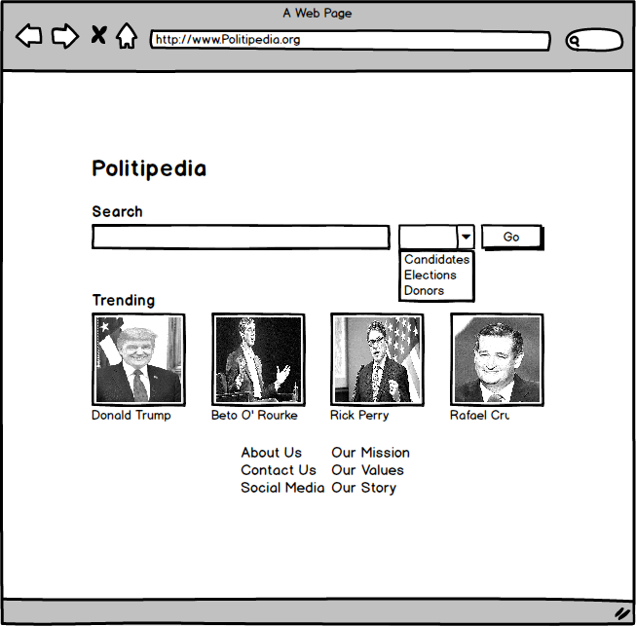
Politipedia (Team Aqua)
Goal: to provide an easy way for people to better inform themselves about US politics
Motivation: making informed decisions about political candidates is difficult
Lots of scattered information to consider (voting records, special interests, etc.)
Implementation: encyclopedia about candidates and elections so voters can make informed political decisions

Slide 2
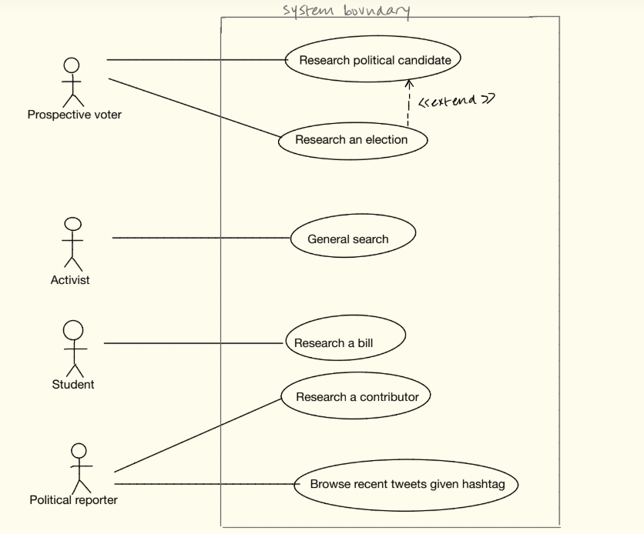
Requirements
Feasibility
Curating and grouping a large amount of data
Different use cases require different data sources
Complex linkages between database tables
Ex. Candidates, donors, sponsored bills, etc.
Querying database efficiently
Fast querying and database indexing

Slide 3
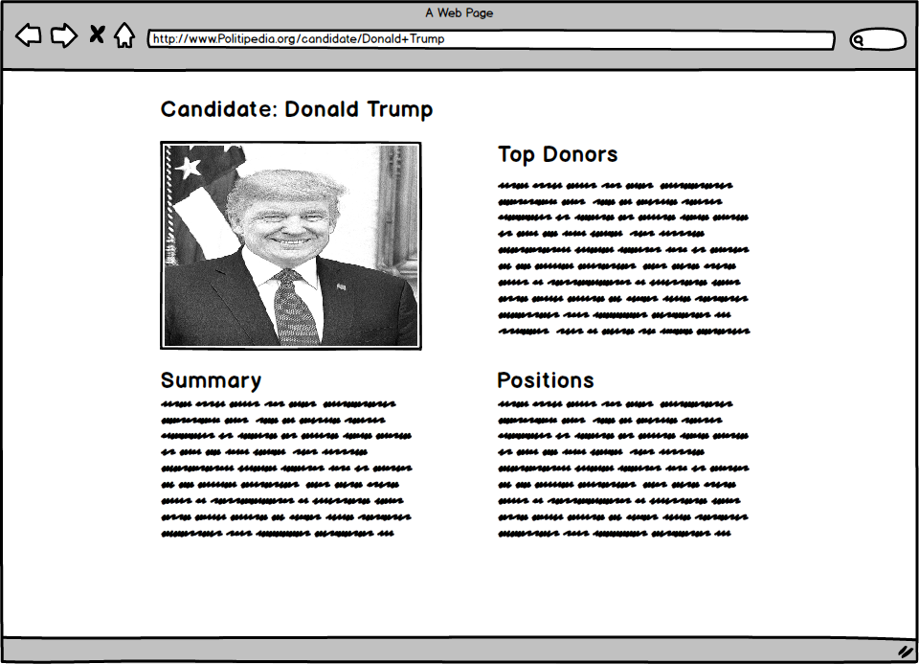
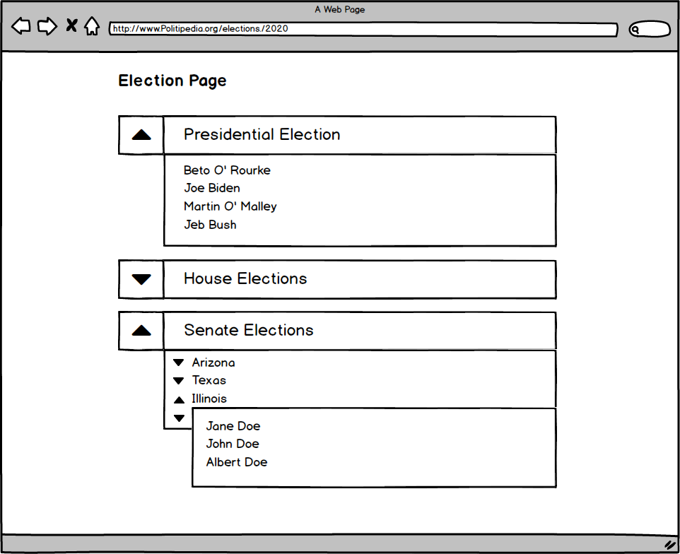
Interface
Candidate Search Results Page
Election Results Search Page

